Slide 1
MAC Sublayer ALOHA

Slide 2
Purpose of the MAC Sublayer
A network link can be:
Point-to-point
Broadcast
In a broadcast network, we need:
A mechanism to decide which device gets to transmit next
A device needs to decide whether a received frame is for me (then process it) or someone else (then ignore it)
MAC is part of layer 2
Alternative terms: Multiple Access / Random Access / Shared Medium

Slide 3
Where do we encounter MAC?
Especially important in LANs and wireless comms
WANs usually use point-to-point links (Satellite links are an exception)

Slide 4
Static/Dynamic Channel Allocation
Static allocation
Traditionally capacity of the channel is split among multiple competing users (e.g., TDM or FDM).
Example: FM radio stations.
Poor performance under bursty traffic
Allocation to a user may go unused
Dynamic allocation
Gives access to users when they need it.
Can improve efficiency, performance and channel utilisation.

Slide 5
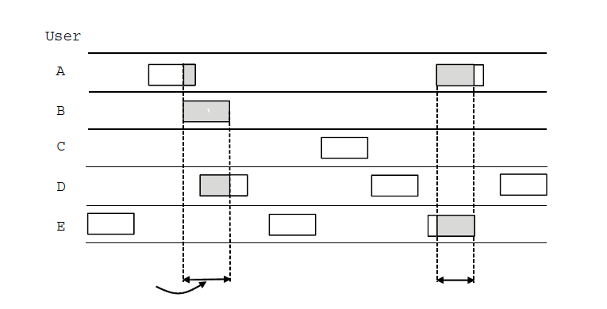
Pure ALOHA
Users transmit when they have data
Retry after random time after collisions
Efficient. Low delay under low load
Collision
Collision
Time

Slide 6
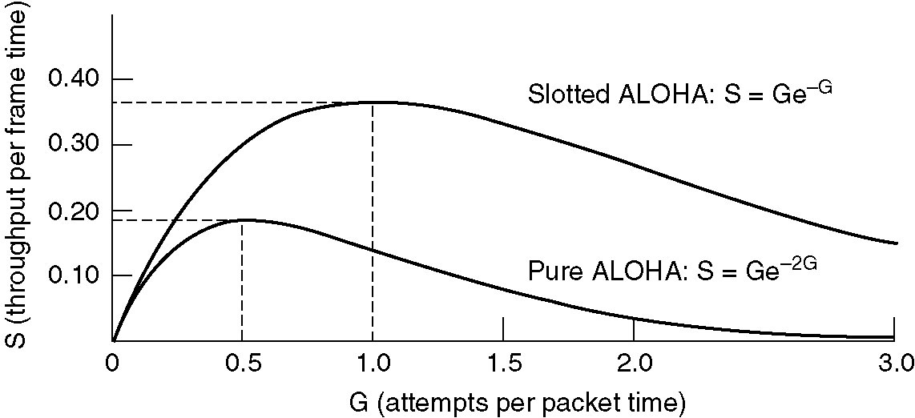
Slotted ALOHA
Synchronises senders to time slots
Twice as efficient compared to pure ALOHA

